Slide 1
COMP 3069
Computer Graphics
Lecture 10: (Last Lecture)
Ray Tracing
Autumn 2018

Slide 2
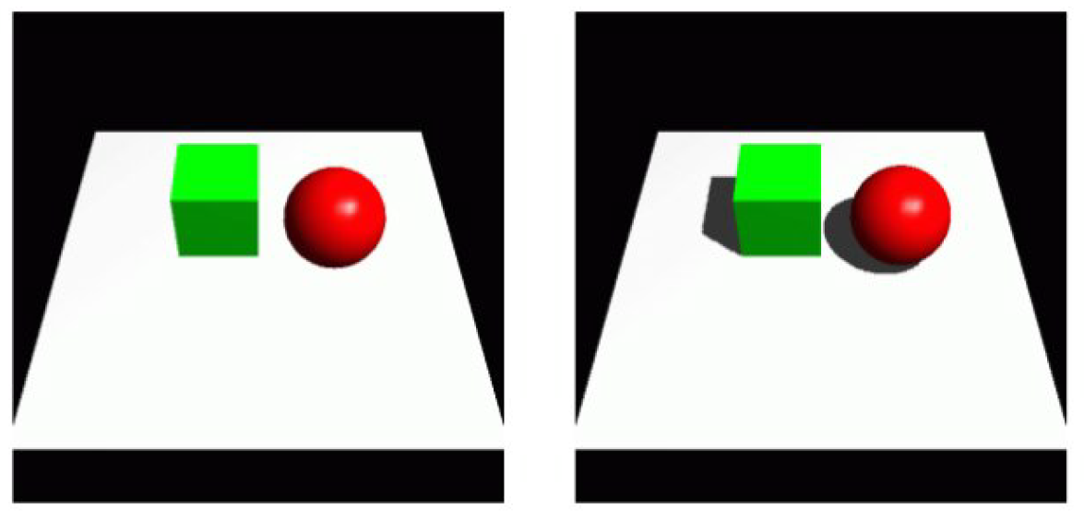
Recap: Shadows
Shadows
  1st Approach: Shadow Volumes
  2n Approach: Shadow Mapping

Slide 3
Today’s Topic
  To produce more “realistic shadows … ”
  And to produce more “realistic lighting effects …”
Ray Tracing … is thus used …
  A kind of “global illumination”, not just local illumination
  But accuracy comes at the expense of additional computation time.

Slide 4
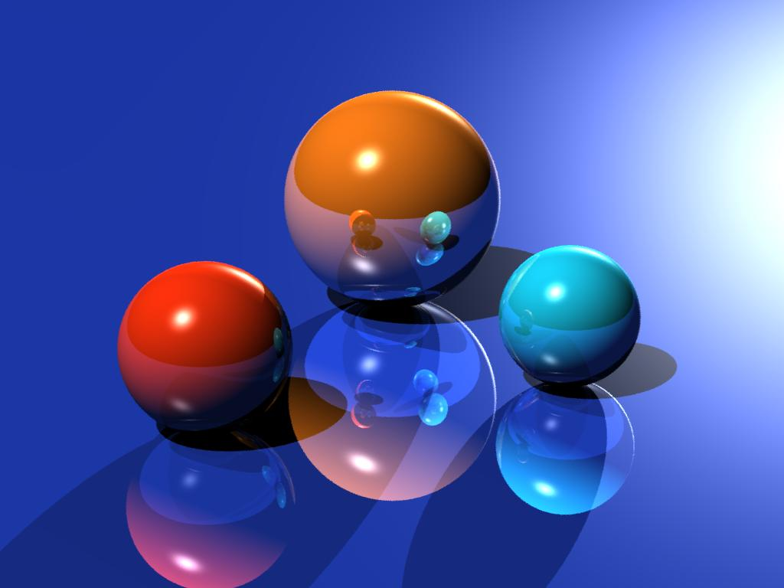
Ray Tracing:
John Tsiombikas

Slide 5
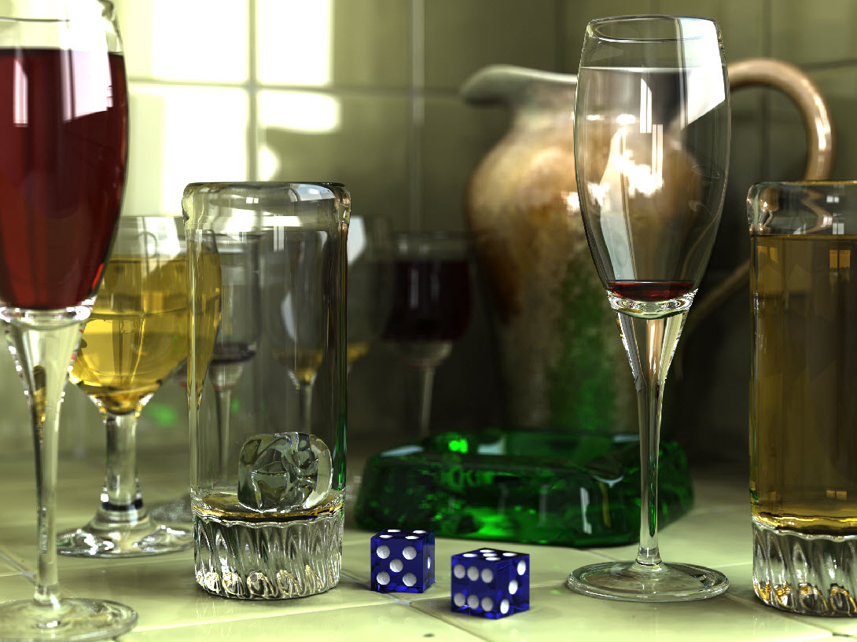
Caustic Graphics

Slide 6
Today’s Topic
Ray Tracing:
Based on geometric optics;
Mirroring, transparency, cast shadows;
Many other optical effects…
And very time consuming…

Slide 7
Ray Casting (Reprise)
Normalized view volume
Algorithm:
Per pixel:
- Calculate intersections
- Determine first one
z
y_{v}
x_{v}
z_{v}
front =
visible
pixel
View plane

Slide 8
Ray Tracing Principle
Ray Tracing:
light source
opaque
projection point
mirroring
view plane
Mirroring and
transparent

Slide 9
Ray Tracing Principle
Ray Tracing:
light source
projection point
pixel
view plane

Slide 10
Ray Tracing Algorithm
var fbuf: array[N,N] of color; { frame-buffer }
For all 1<= i, j <=N do { for all pixels }
  fbuf [i,j] := RayTrace((0,0,0),(i,j,d), 1)
projection point
pixel
d

Slide 11
Ray Tracing Algorithm
function RayTrace(P: point; u:vector; level: integer): color;
if level > MaxLevel or GetIntersections (P, u, t, N) = 0
then return BkColor;
level := level+1;
col := k_{amb}*I_{amb};
Q := P + ut;
if (L− Q)·N > 0 and GetIntersections (Q, L − Q) = 0
then col := col + k_{dif}*I_{dif}* ((L − Q)·N)
+ k_{spec}*I_{spec}*power(H·N, n_{spec});
col := col + k_{ref}*Raytrace(Q, R(u,N), level);
col:= (1–k_{tran})*col + k_{tran}*Raytrace(Q, T(u,N), level);
return col;
Reflected
ray
N
H
R
P
L
u
Q
T
Transmitted
(or refracted)
ray
where u = incoming ray
V = viewing direction = -u
L-Q = light source direction
H = (V+L)/2

Slide 12

Calculation Intersections
function GetIntersections (P: point; u: vector; t: array of real;
N: array of vector): integer;
{ Get the intersections of a line with the scene }
For all objects do:
Calculate intersection points with surface;
Store the results in the arrays t and N,
sorted for t.
Return the number of intersection points.
Equation line:
P
u
t

Slide 13

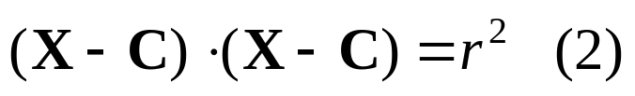
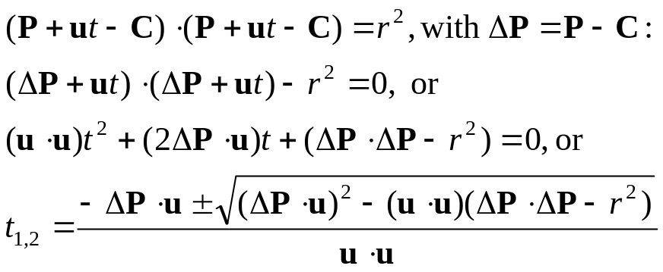
Line/Sphere Intersections
Equation line:
P
Equation sphere:
u
t
Q
Substitute (1) in (2):
C
r

Slide 14

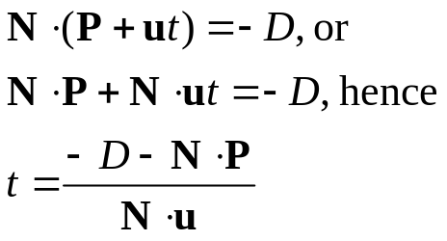
Line/Polygon Intersection
Equation line:
N
P
u
t
Equation plane polygon:
Q
Substitute (1) in (2):
Check if Q is inside polygon

Slide 15
Ray Tracing Acceleration
Limit intersection calculations:
Hierarchy of Bounding Volumes
Bounding Boxes
Bounding Spheres

Slide 16
Ray Tracing Acceleration
Limit intersection calculations:
Space-subdivision
Regular
Adaptive (Octtree, quadtree)

Slide 17
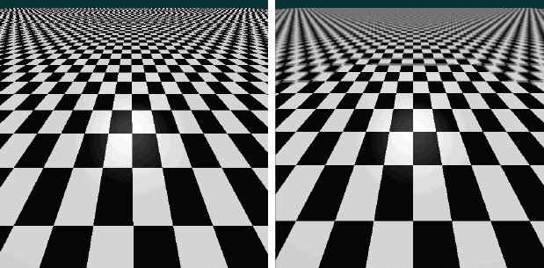
Aliasing
Generic problem of raster graphics
Shapes are continuous, pixels are discrete
Jagged edges, Moiré patterns, flickering textures, …
Especially annoying during animation
Aliased Anti-aliased

Slide 18
Aliasing
pixel
1 ray/pixel: blocky patterns
ray

Slide 19
Anti-Aliasing
pixel
average 5 rays/pixel:
smoother transitions
ray

Slide 20
Anti-Aliasing
pixel
adaptive sampling:
more efficient, not fail save
ray

Slide 21
Anti-Aliasing
pixel
dense patterns
give problems
ray

Slide 22
Anti-Aliasing
pixel
dense patterns
give problems
ray

Slide 23
Anti-Aliasing
pixel
dense patterns
give problems
ray

Slide 24
Anti-Aliasing
pixel
random sampling gives
a better result
ray

Slide 25
Anti-Aliasing
pixel
random sampling gives
a better result
ray

Slide 26
Anti-Aliasing
pixel
random sampling gives
a better result
ray

Slide 27
More Optical Effects …

Slide 28
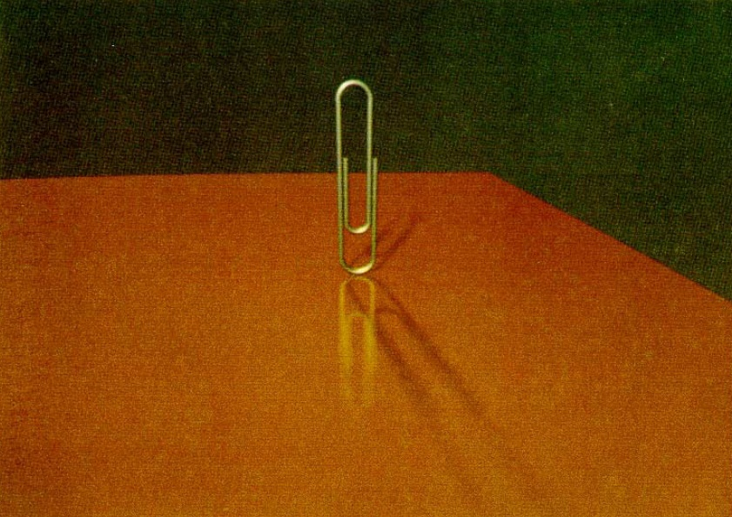
Imperfect reflection
Non-point light source
Cook, Porter, Carpenter, 1984

Slide 29
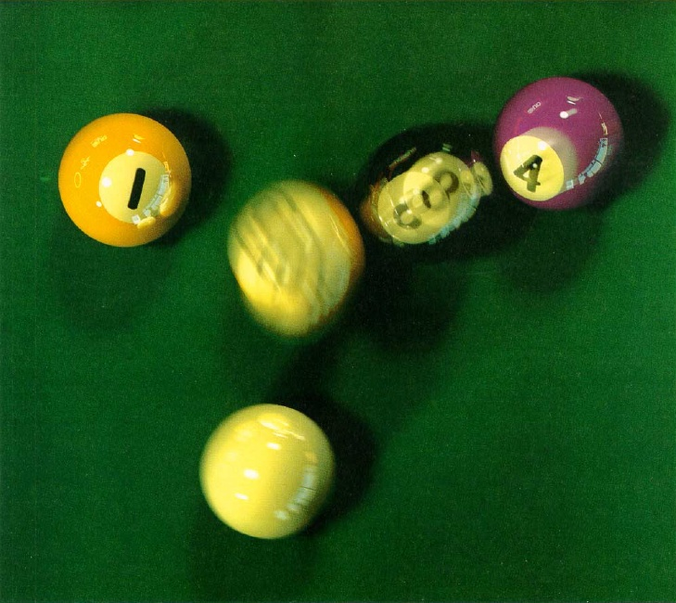
Distributed ray tracing 1
Motion blur
Cook, Porter, Carpenter, 1984

Slide 30
Distributed Ray Tracing
Monte Carlo sampling
Typically 16 rays/pixel;
Each ray is shifted along a small random vector (jitter)
Rough reflecting surfaces,
non-point light sources,
depth of field,
motion blur
pixel
ray

Slide 31
Distributed Ray Tracing
Rough reflecting surfaces, non-point light sources, depth of field,
motion blur
R
P
L
u
T

Slide 32
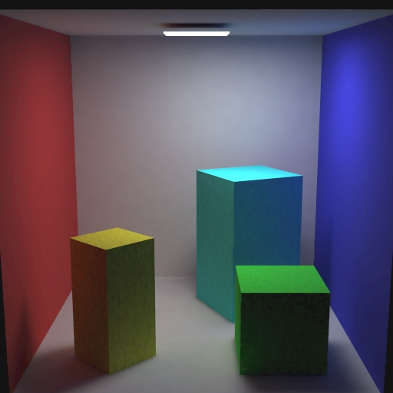
Radiosity
Surface-surface
inter-reflection
Physically based simulation
Calculate for each polygon the balance between incoming and outgoing light
Important for architecture and indoor scenes
Cornell box

Slide 33
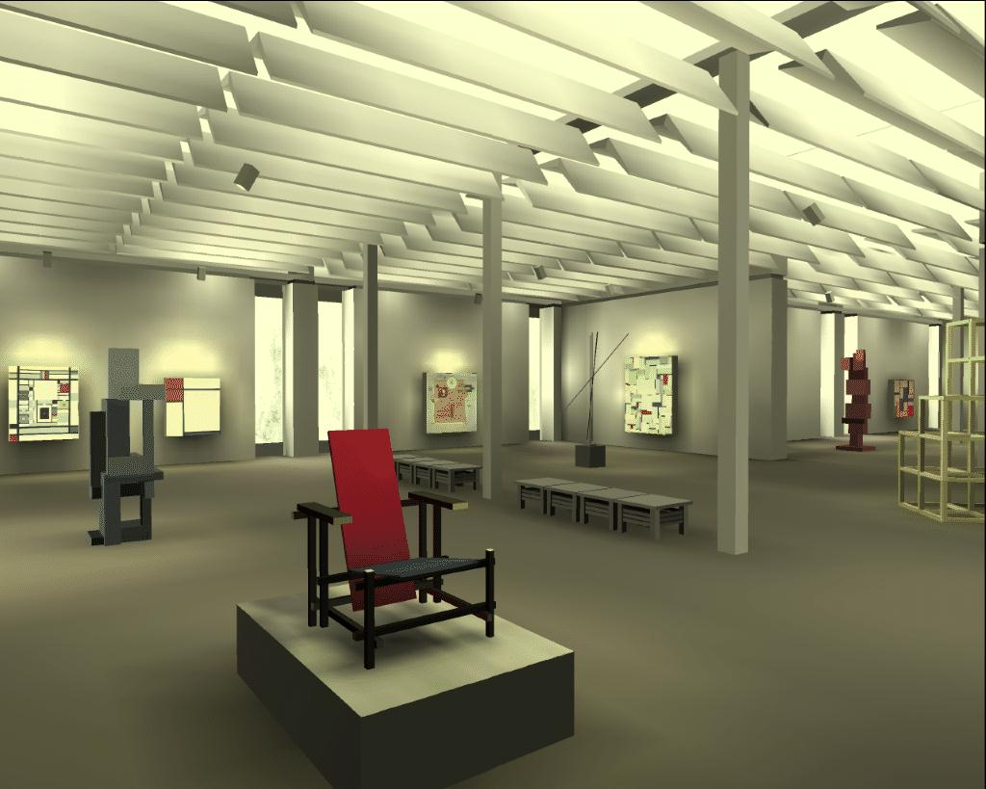
Cohen et al., 1988

Slide 34
Finally
This concludes our tour through the world of 2D and 3D “Computer Graphics”.
Next semester, welcome to enroll into my New module “Fundamentals of Information Visualisation (FIV)”.

